Slide 1
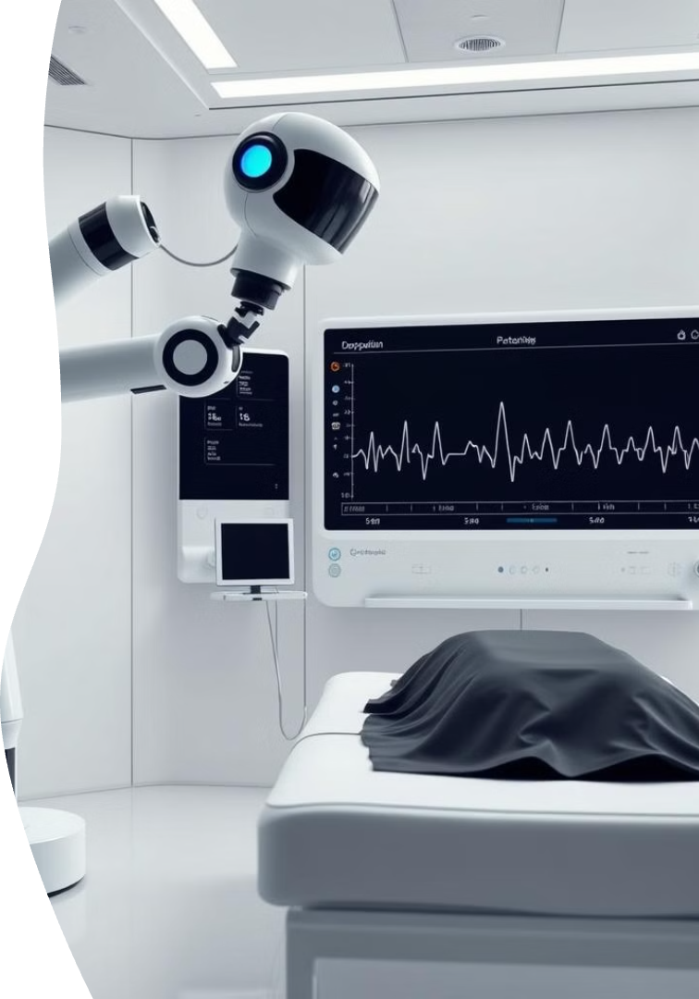
AI Cure: A Real-Life Application of Python in Healthcare
by tanvi shinde
ts
Notes:
This presentation will explore a real-life application of Python in the healthcare industry, specifically in the development of an AI-powered diagnostic tool called "AI Cure". The AI Cure system leverages advanced machine learning algorithms to analyze medical images, such as X-ray scans, and provide accurate and timely diagnoses to healthcare professionals. By automating the image analysis process, AI Cure can help reduce the workload on medical staff, allowing them to focus on providing the best possible care to patients. The use of Python in the development of AI Cure has been instrumental in its success, as the language's flexibility and extensive library ecosystem have enabled the creation of a powerful and scalable solution. I'm excited to share more details about how AI Cure is transforming the healthcare industry and the role of Python in making this technology a reality.

Slide 2

The Role of Python in Healthcare
Data Analysis and Machine Learning
Medical Image Processing
Python's robust libraries like Pandas and Scikit-learn empower healthcare professionals to analyze patient data and develop predictive models.
AI algorithms built with Python are transforming medical imaging, enabling faster and more accurate diagnoses, and personalized treatments.

Slide 3
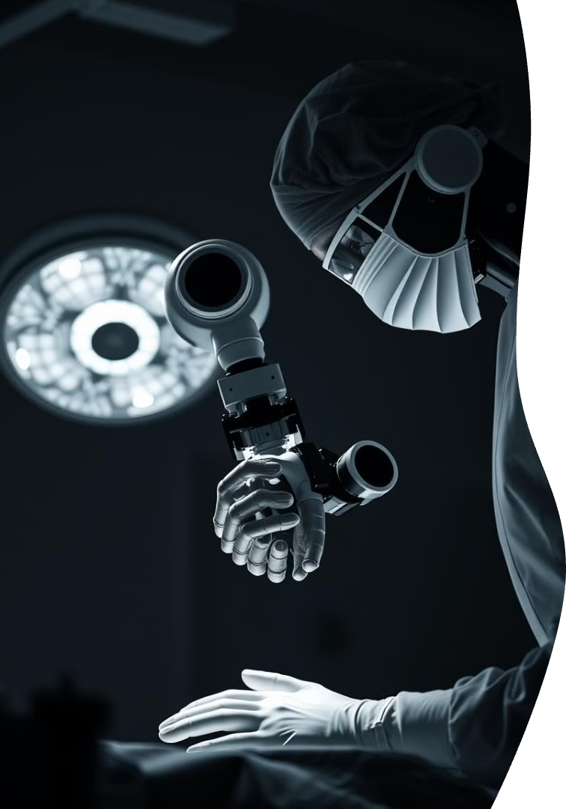
AI Applications in the Medical Industry
1
Disease Diagnosis
2
Drug Discovery
AI can analyze medical images and patient records to detect diseases earlier and more accurately, leading to faster intervention.
AI algorithms can accelerate the drug discovery process by identifying promising drug candidates and optimizing drug formulations.
3
Personalized Medicine
4
Robotics and Surgery
AI algorithms can tailor treatment plans to individual patients based on their genetics, lifestyle, and medical history.
AI-powered robots are assisting surgeons in performing complex procedures with greater precision and minimally invasive techniques.

Slide 4


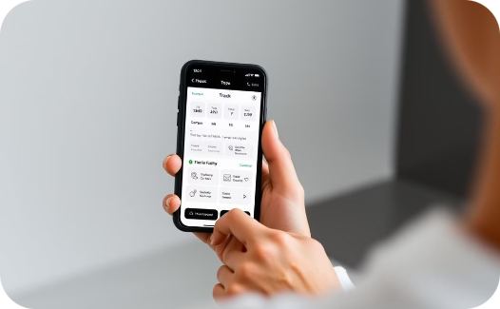
Case Studies: Startups Leveraging Python and AI
AI-Powered Health Monitoring
Virtual Health Assistants
Personalized Wellness Applications
AI-powered chatbots provide 24/7 patient support, answer questions, and manage appointments.
Companies are developing wearable devices that monitor vital signs and alert doctors to potential health issues.
Apps use AI to provide customized diet and exercise recommendations based on individual needs and goals.

Slide 5
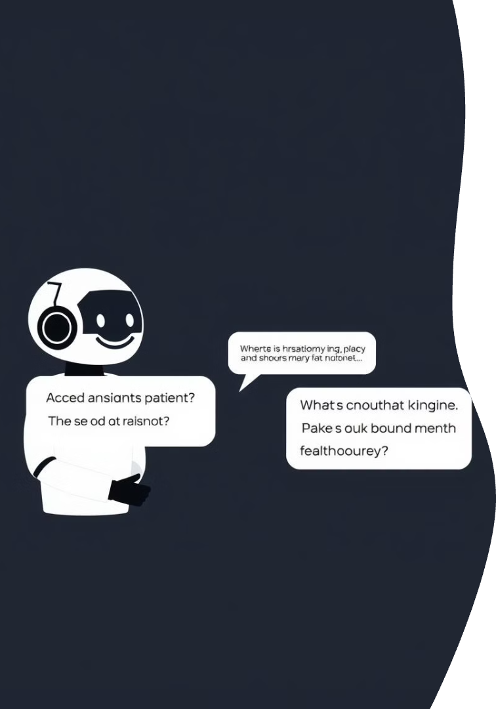



Improving Patient Outcomes with AI-Powered Tools
Early Disease Detection
AI algorithms can detect subtle patterns in medical images and patient data, leading to earlier diagnoses and treatment.
Precise Treatment Planning
AI can optimize radiation therapy plans and personalize chemotherapy regimens based on individual patient characteristics.
Enhanced Patient Care
AI-powered tools can automate tasks like scheduling appointments and providing medication reminders, freeing up clinicians to focus on patient care.

Slide 6




AI Cure: A Real-Life Application of Python in Healthcare
Data Collection & Preparation
Python's libraries like Pandas and NumPy are used to collect, clean, and prepare large datasets of patient information.
Model Training
Machine learning algorithms are trained on this data to identify patterns and develop predictive models.
Model Validation & Deployment
Models are rigorously validated to ensure accuracy and reliability before being deployed in real-world applications.
Personalized Treatment Plans
AI algorithms can personalize treatment plans based on individual patient characteristics, leading to more effective outcomes.

Slide 7

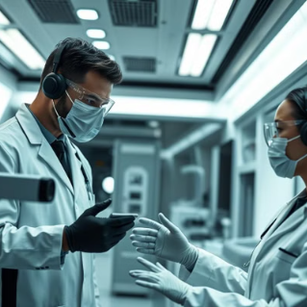
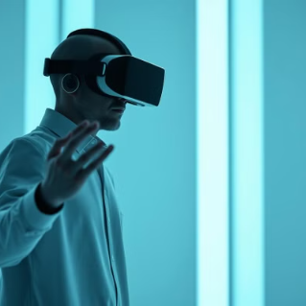
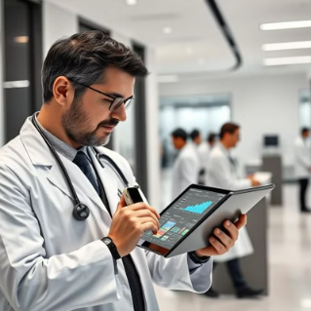
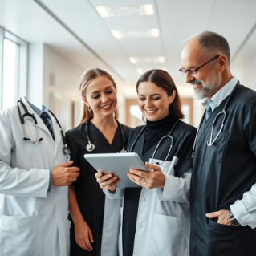
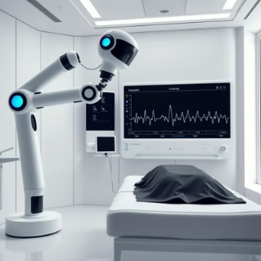
Overcoming Challenges in Implementing AI in
The Future of AI in Medical Sciences

Slide 8
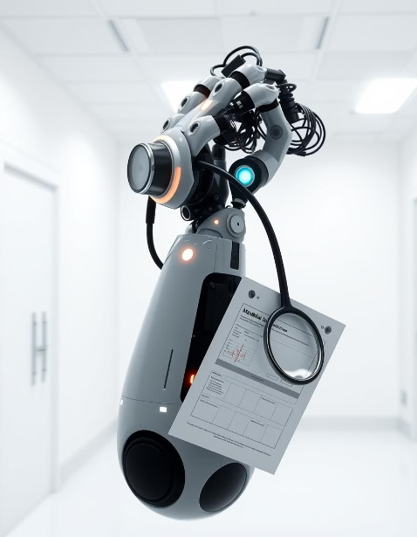
thank you… all for your time and attention today .

